Slide 1


Stock Price Prediction
Is it possible?

Slide 2



ASX Australian Investor Study 2020
High value investors
45% are women
Next generation investor starts from the age of 18

Slide 3
ASX Australian Investor Study 2020
Number of investors remained stable over the past 15 years
41% invest under $100k and 26% invest between $100k-$500k

Slide 4
ASX Australian Investor Study 2020
65% consider potential return on investment when investing
86% invested within personal capacity

Slide 5


ASX Australian Investor Study 2020
41% prefer to receive investor education via YOUTUBE

Slide 6

Business question
How to increase potential return on investment from buying and selling stocks?

Slide 7
Dataset
Commonwealth Bank of Australia stock price historical data from October 1991 to September 2022

Slide 8
Dataset

Slide 9
Data pipeline
Data Acquisition
Data Pre-Processing
Data Integration
Model Selection
Training
Comparison
Validation
Decision Making
Evaluation

Slide 10
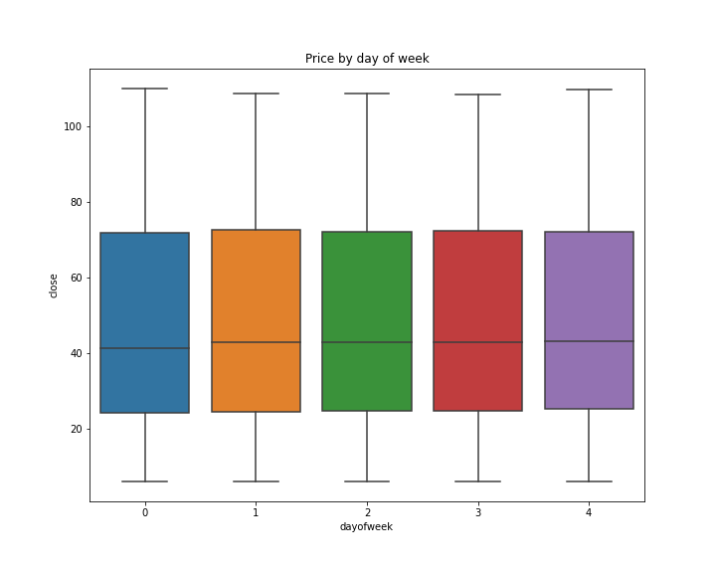
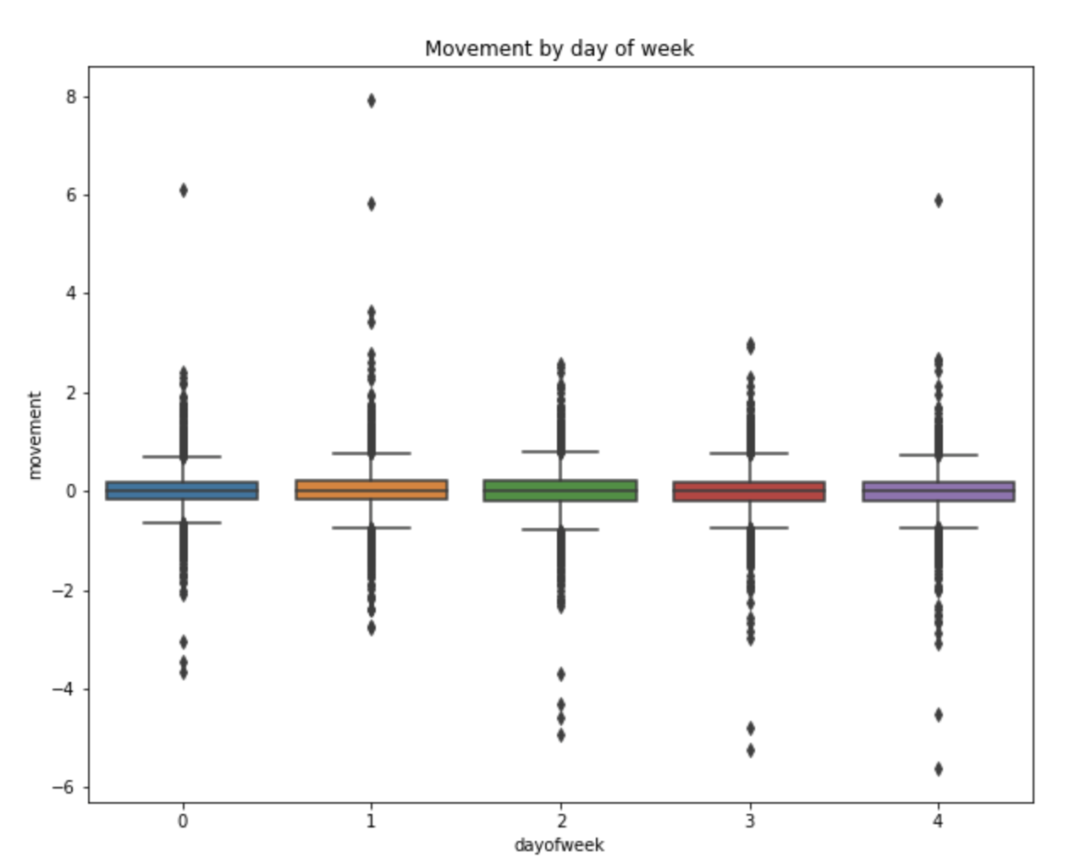
Key findings
Closing price is slightly lower on Monday
Movement of price is more positive on Tuesday and more negative on Friday

Slide 11
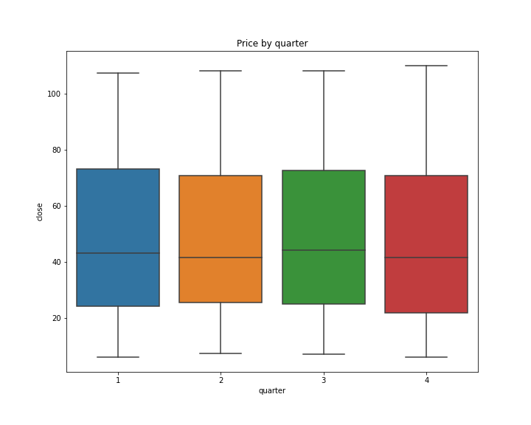
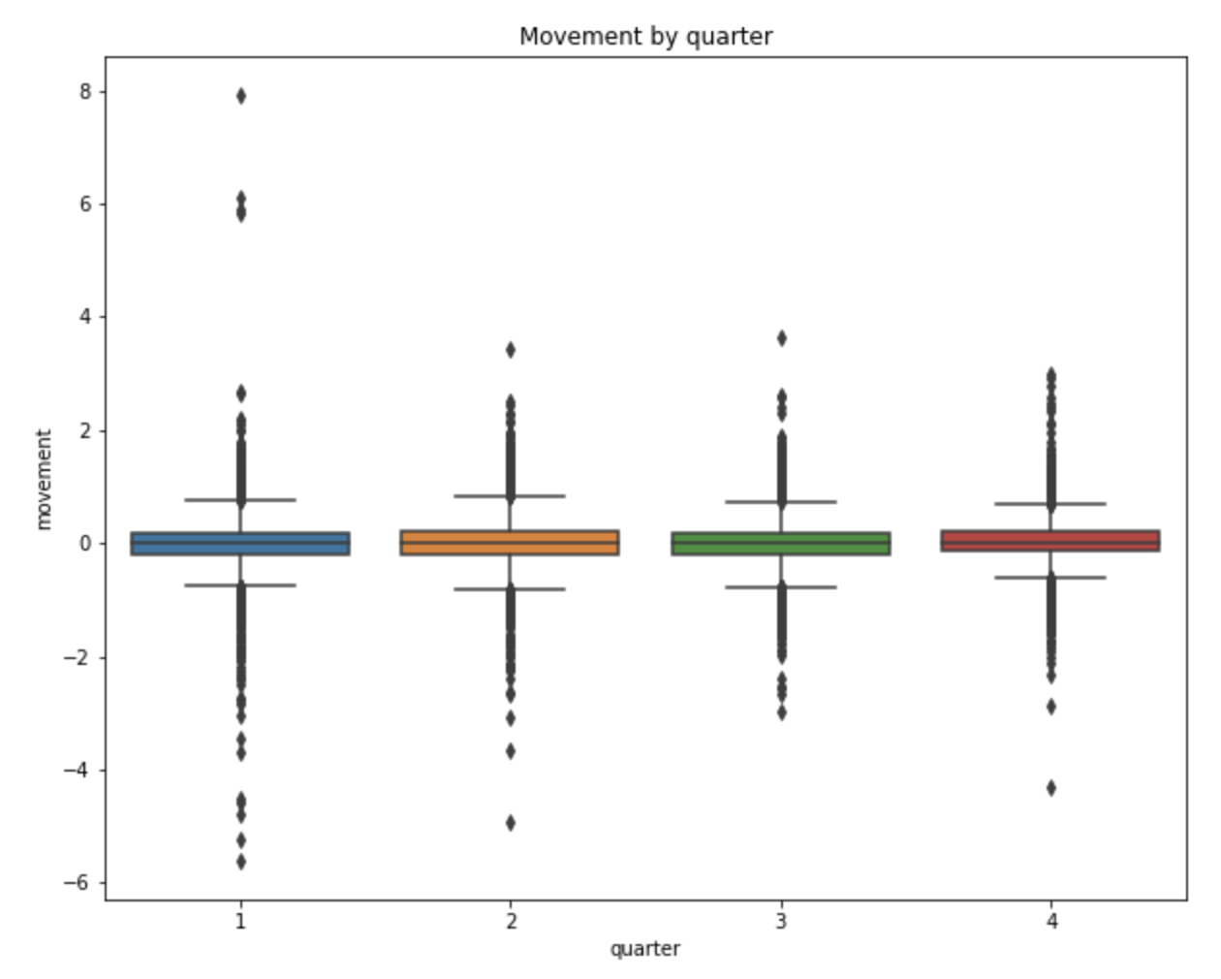
Key findings
Closing price is low between April - June
There is a big window of movement from January – March and less movement between July - September

Slide 12
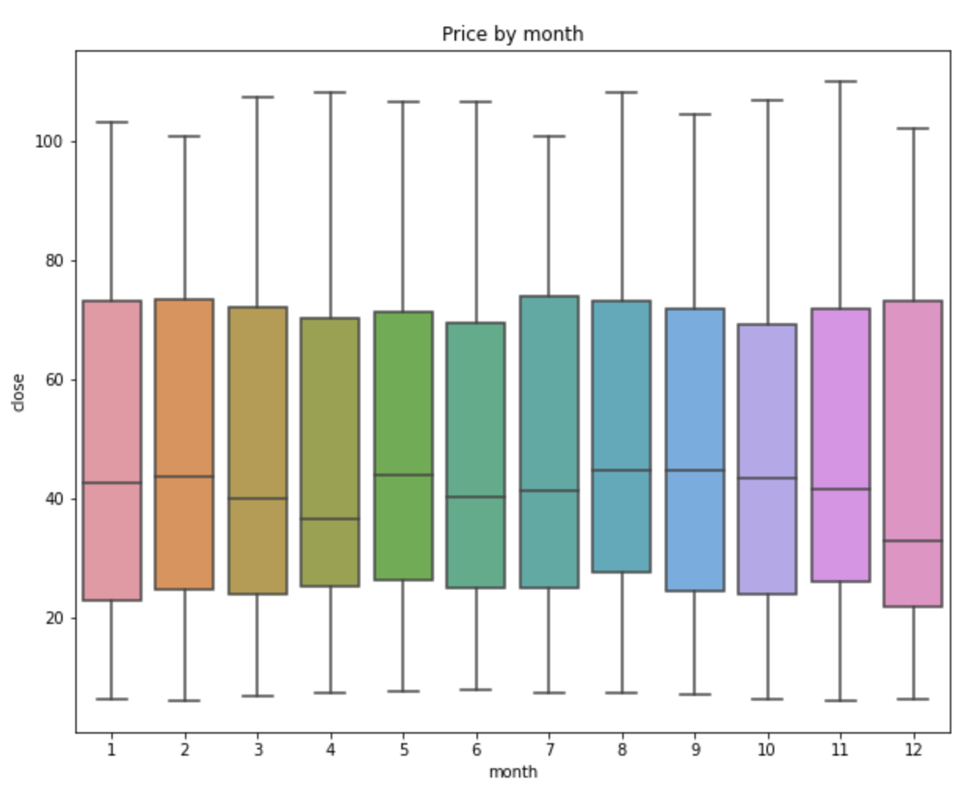
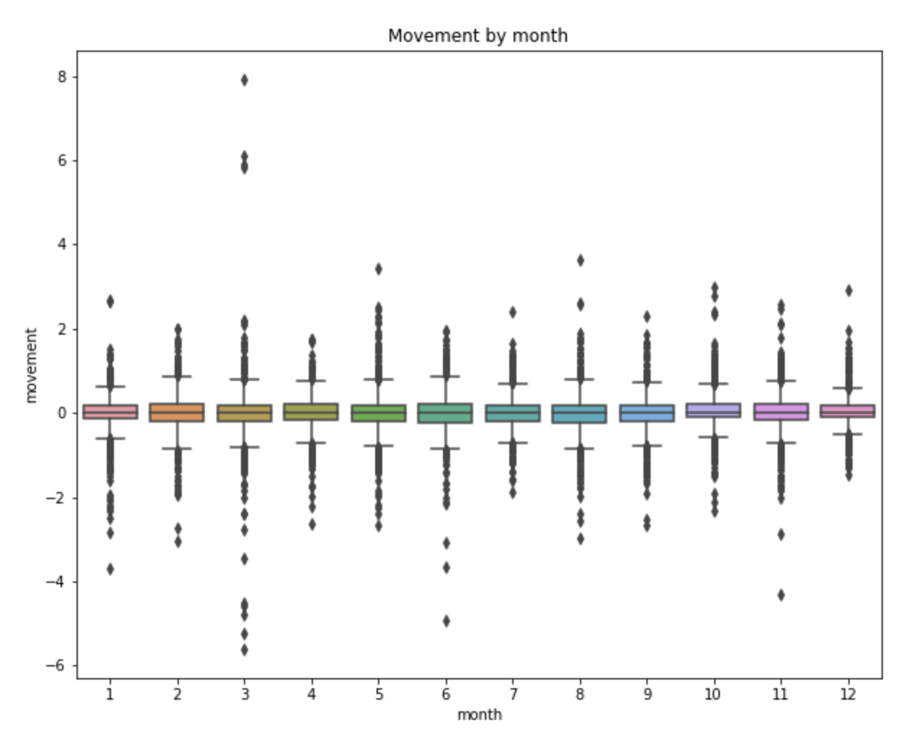
Key findings
Closing price is highest in February and lowest in April due to Ex-dividend in Feb and dividend payment in March
There is very high movement of price before dividend payment in March and more negative movement in April

Slide 13
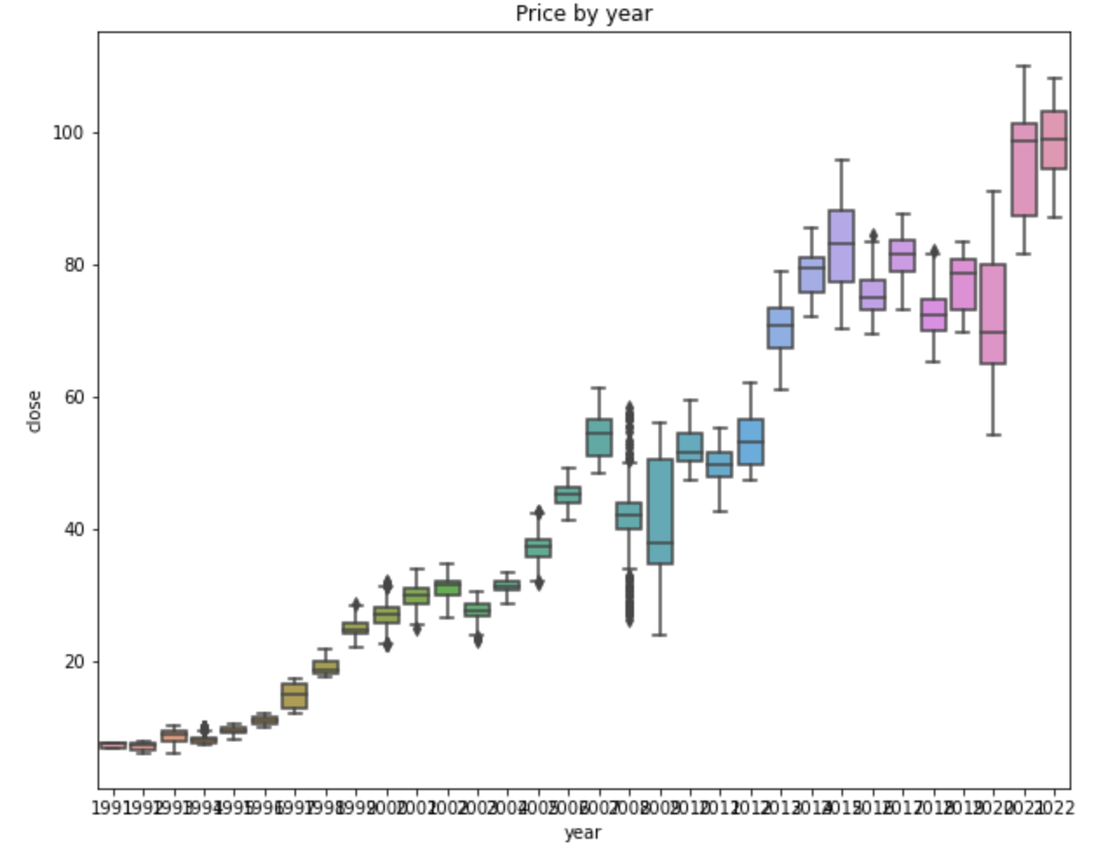
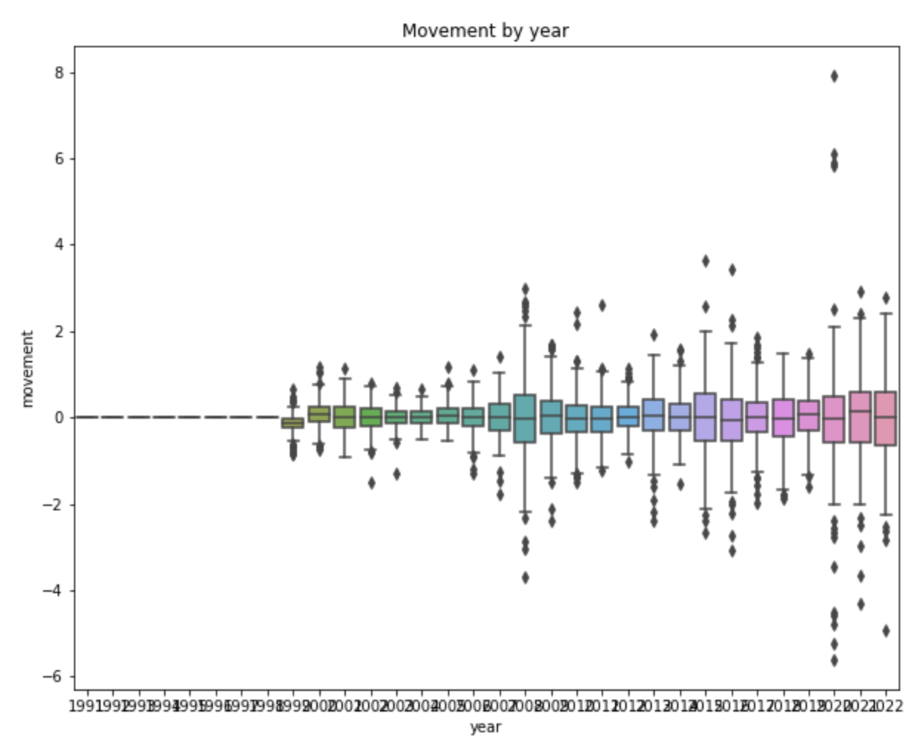
Key findings
CBA closing price remained constantly high overtime which indicates that the company preserves its value well and it is a good share for long term investment
As CBA has been performing well, more investors are buying and selling and hence the movement has been a lot wider than the past including Next Gen investor

Slide 14
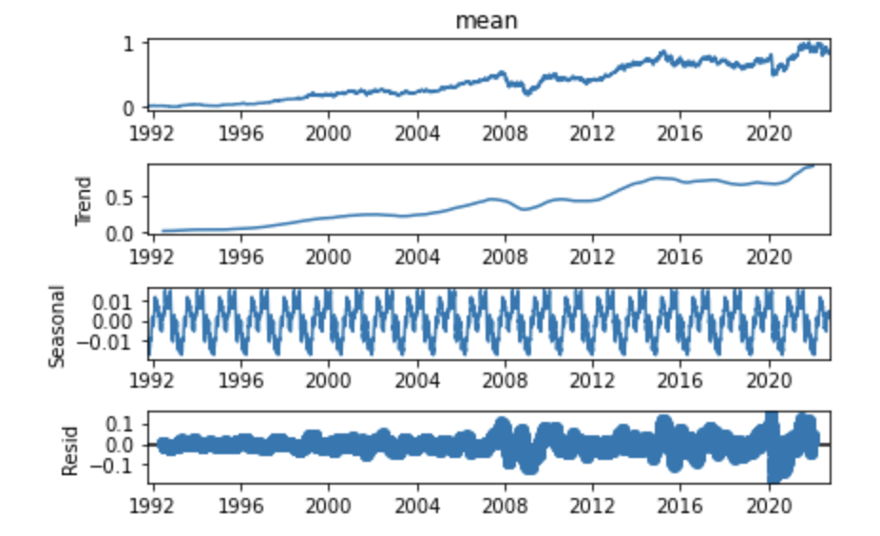
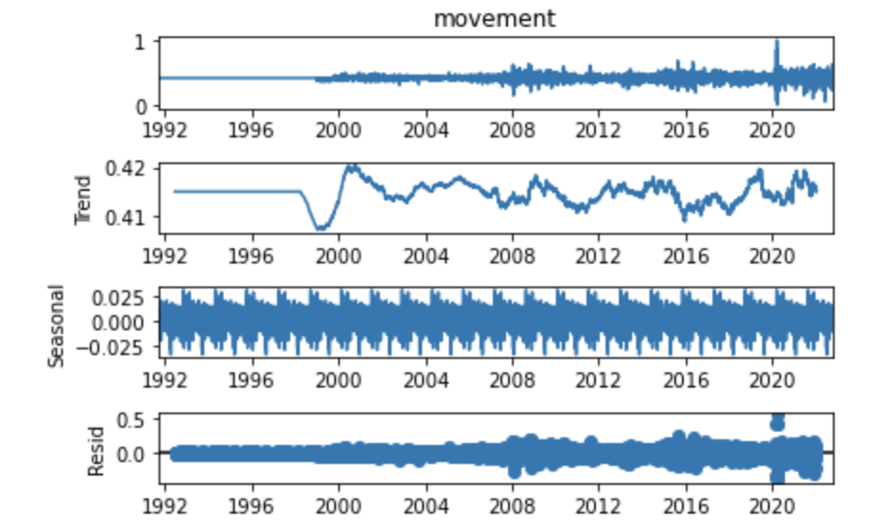
Model results: Seasonal Arima Model (SARIMAX)
Data visualisation on seasonal component of this dataset
Clear sign of trend in price but not so much in movement
Clear sign of seasonal component in both group
More random noise (residual) in price than movement
price

Slide 15
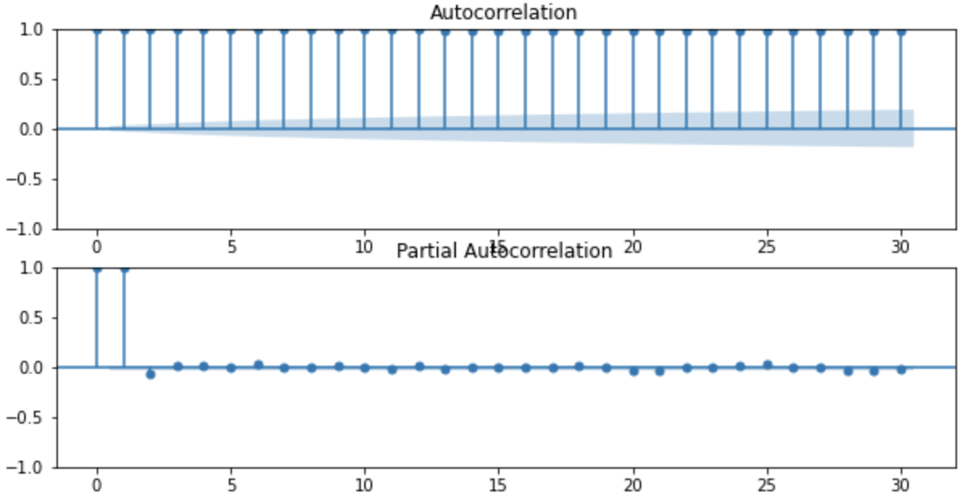
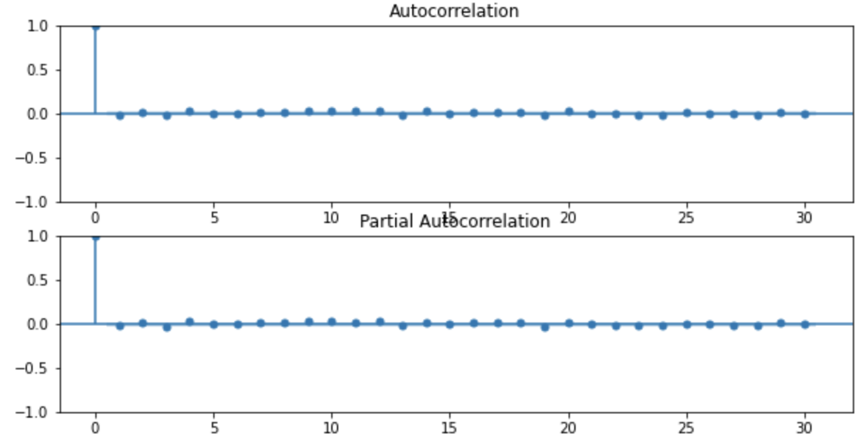
Model results: Seasonal Arima Model (SARIMAX)
Autocorrelation function and Partial autocorrelation chart showing correlation coefficients between timeseries and lags
However, we’re also use auto arima function to do a stepwise search for best fits parameter of the model

Slide 16
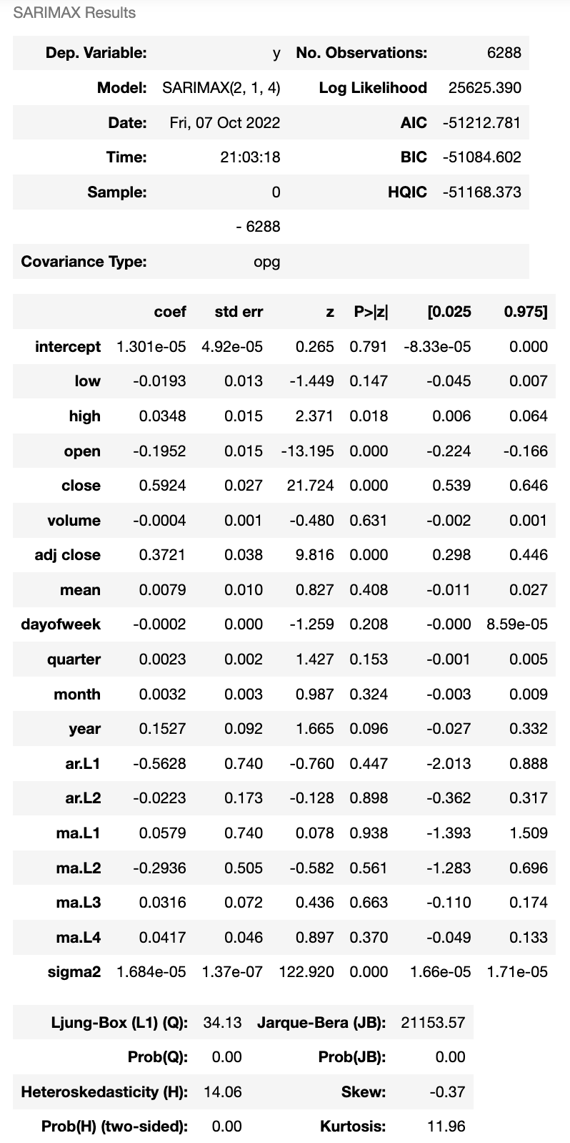
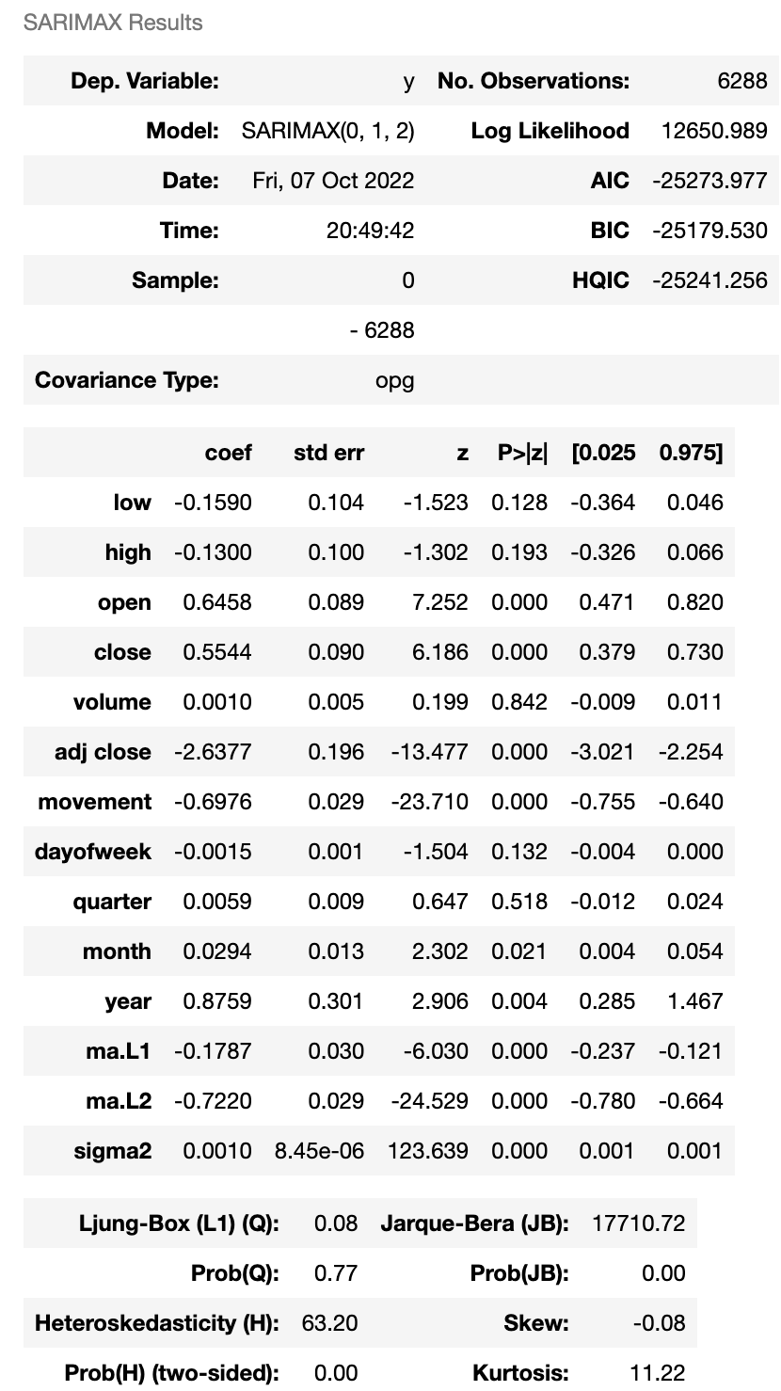
Model results: Seasonal Arima Model (SARIMAX)
Price
Movement
Auto_arima results;
Best order for p, d, and q for pricing model are 2, 1, 4
Auto_arima results;
Best order for p, d, and q for movement model are 0, 1, 2

Slide 17
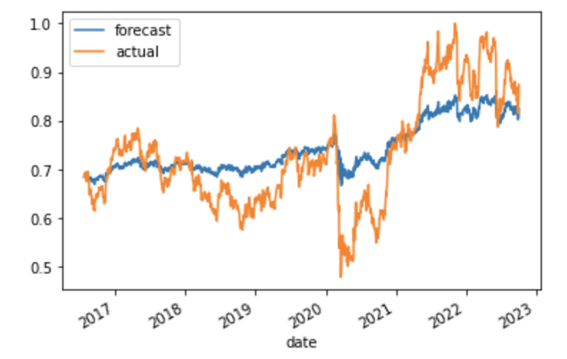
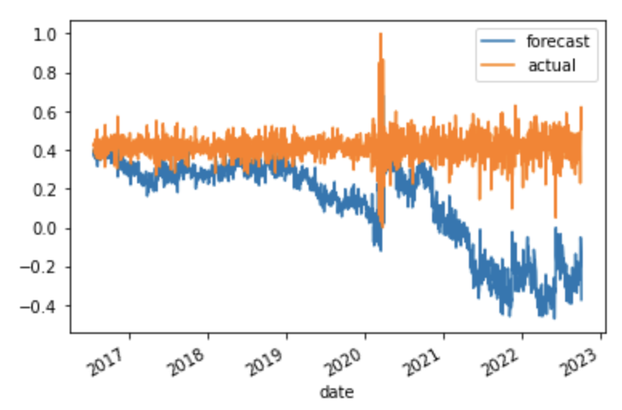
Model results: Seasonal Arima Model (SARIMAX)
Best model: ARIMA (2,1,4)
Best model: ARIMA (0,1,2)
RMSE = 0.0699
RMSE = 0.3793

Slide 18
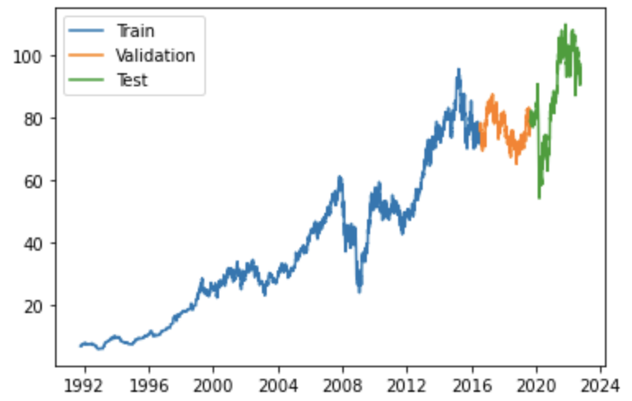
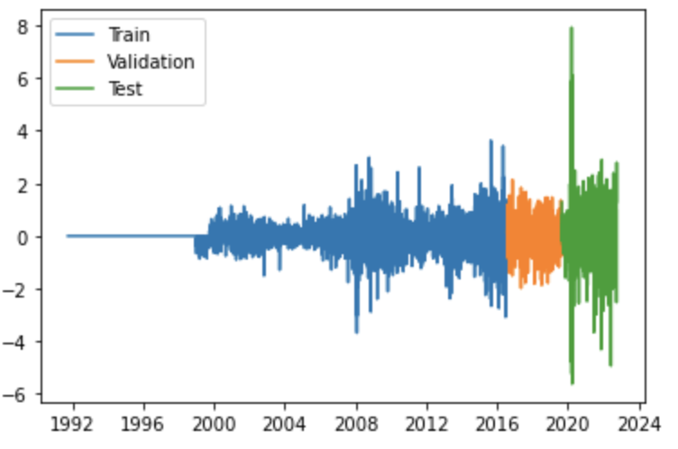
Model results: Long short-term memory Neural Network (LSTM)
Data split:

Slide 19
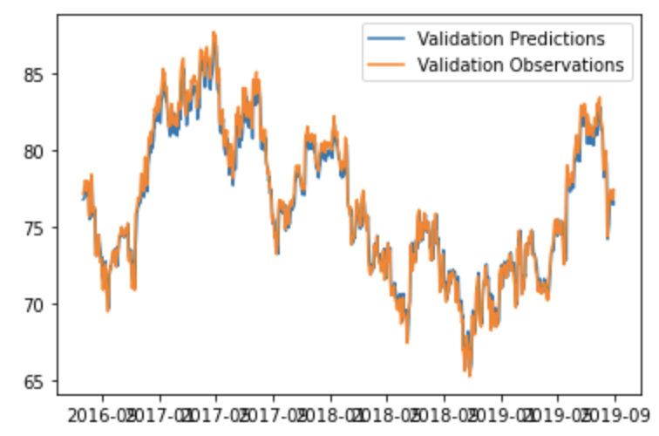
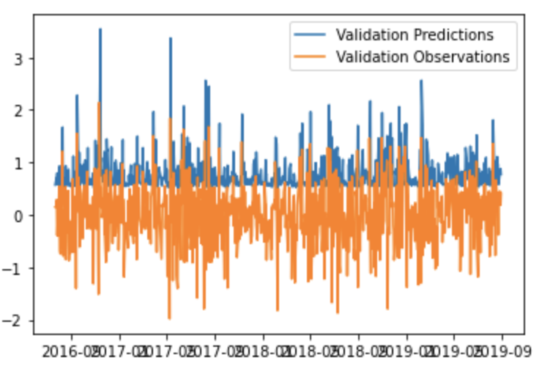
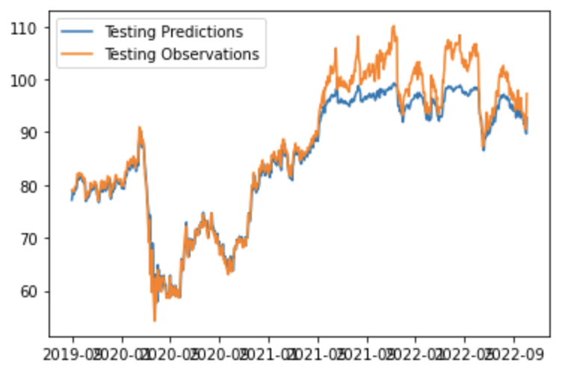
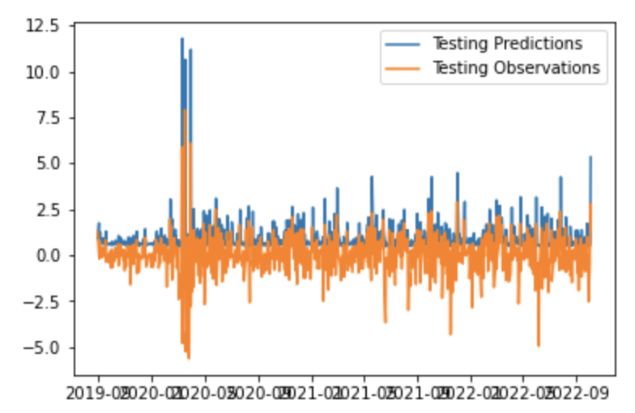
Model results: Long short-term memory (LSTM)
Price
Movement

Slide 20
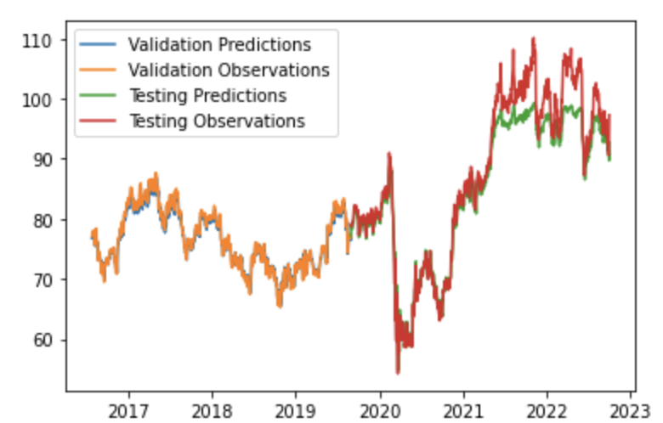
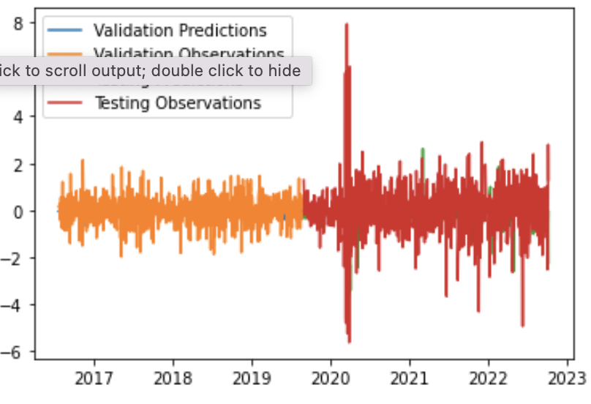
Model results: Long short-term memory (LSTM)
RMSE = 3.4819
RMSE = 1.1693

Slide 21
Summary & Next step
Arima model performs better on predicting closing price than volume.
However, it performed better on training set than test set which may cause by overfitting of the data
Long Short-Term Memory model performs better on predicting movement of stock price than the price itself.
Although the window of share price movement is quite small and we cannot afford too much of an error. We’ll go ahead with LSTM to further develop and train to predict movement of the share price before deployment

Slide 22
Question?
Thank you ☺

